Slide 1
DATABASE SYSTEM CONCEPTS (6th Edition)-Abraham Silberschatz
Chapter 8: Relational Database Design
Farhana Akter Sunny
Sr. Lecturer
Dept. of Computer Science and Engineering

Slide 2
Normalization of Database
Database Normalization is a technique of organizing the data in the database.
Normalization is a systematic approach of decomposing tables to eliminate data redundancy and data integrity like Insertion, Update and Deletion Anomalies.
It is a multi-step process that puts data into tabular form by removing duplicated data from the relation tables.
Normalization is used for mainly two purpose,
Eliminating redundant(useless) data.
Ensuring data dependencies make sense i.e data is logically stored.

Slide 3
Normalization of Database
        Normalization is a process that “improves” a database design by generating relations that are of higher normal forms.
        The objective of normalization:
        “to create relations where every dependency is on the key, the whole key, and nothing but the key”.

Slide 4
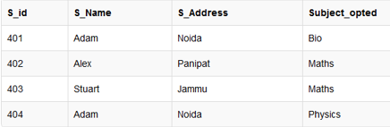
Updating Anomaly : To update address of a student who occurs twice or more than twice in a table, we will have to update S_Address column in all the rows, else data will become inconsistent.
Insertion Anomaly : Suppose for a new admission, we have a Student id(S_id), name and address of a student but if student has not opted for any subjects yet then we have to insert NULL there, leading to Insertion Anomaly.
Deletion Anomaly : If (S_id) 401 has only one subject and temporarily he drops it, when we delete that row, entire student record will be deleted along with it.

Slide 5
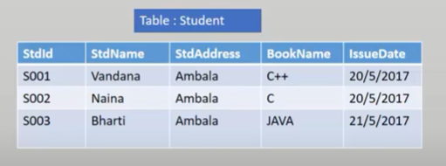
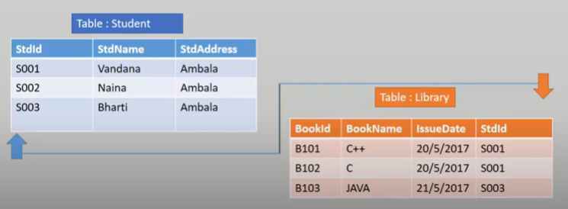

Slide 6
Normalization
There is a sequence to normal forms:
  1NF is considered the weakest,
  2NF is stronger than 1NF,
  3NF is stronger than 2NF, and
  BCNF is considered the strongest
Also,
  any relation that is in BCNF, is in 3NF;
  any relation in 3NF is in 2NF; and
  any relation in 2NF is in 1NF.

Slide 7
Normalization
1NF
a relation in BCNF, is also in 3NF
a relation in 3NF is also in 2NF
a relation in 2NF is also in 1NF
2NF
3NF
BCNF

Slide 8
Normalization of Database
        We consider a relation in BCNF to be fully normalized.
        The benefit of higher normal forms is that update semantics for the affected data are simplified.
        This means that applications required to maintain the database are simpler.
        A design that has a lower normal form than another design has more redundancy. Uncontrolled redundancy can lead to data integrity problems.
First we introduce the concept of functional dependency

Slide 9
Functional Dependencies
We say an attribute, B, has a functional dependency on another attribute, A, if for any two records, which have the same value for A, then the values for B in these two records must be the same. We illustrate this as:
  A → B
Example: Suppose we keep track of employee email addresses, and we only track one email address for each employee. Suppose each employee is identified by their unique employee number. We say there is a functional dependency of email address on employee number:
    employee number → email address

Slide 10
Functional Dependencies
EmpNum
EmpEmail
EmpFname
EmpLname
123
jdoe@abc.com
John
Doe
456
psmith@abc.com
Peter
Smith
555
alee1@abc.com
Alan
Lee
633
pdoe@abc.com
Peter
Doe
787
alee2@abc.com
Alan
Lee
If EmpNum is the PK then the FDs:
EmpNum → EmpEmail
EmpNum → EmpFname
EmpNum → EmpLname
must exist.

Slide 11
Functional Dependencies
EmpNum → EmpEmail
EmpNum → EmpFname
EmpNum → EmpLname
3 different ways you might see FDs depicted
EmpEmail
EmpNum
EmpFname
EmpLname
EmpNum EmpEmail EmpFname EmpLname

Slide 12
Determinant
Functional Dependency
EmpNum → EmpEmail
Attribute on the LHS is known as the determinant
  EmpNum is a determinant of EmpEmail

Slide 13
Transitive dependency
Consider attributes A, B, and C, and where
A → B and B → C.
Functional dependencies are transitive, which means that we also have the functional dependency A → C
We say that C is transitively dependent on A through B.

Slide 14
Transitive dependency
EmpNum → DeptNum
EmpNum EmpEmail DeptNum DeptNname
DeptNum → DeptName
EmpNum EmpEmail DeptNum DeptNname
DeptName is transitively dependent on EmpNum via DeptNum
    EmpNum → DeptName

Slide 15
Partial dependency
A partial dependency exists when an attribute B is functionally dependent on an attribute A, and A is a component of a multipart candidate key.
InvNum
LineNum
Qty
InvDate
Candidate keys: {InvNum, LineNum} InvDate is partially dependent on {InvNum, LineNum} as InvNum is a determinant of InvDate and InvNum is part of a candidate key

Slide 16
First Normal Form
First Normal Form
We say a relation is in 1NF if all values stored in the relation are single-valued and atomic.
1NF places restrictions on the structure of relations. Values must be simple.

Slide 17
First Normal Form
The following in not in 1NF
EmpNum
EmpPhone
EmpDegrees
123
233-9876
333
233-1231
BA, BSc, PhD
679
233-1231
BSc, MSc
EmpDegrees is a multi-valued field:
  employee 679 has two degrees: BSc and MSc
  employee 333 has three degrees: BA, BSc, PhD

Slide 18
First Normal Form
EmpNum
EmpPhone
EmpDegrees
123
233-9876
333
233-1231
BA, BSc, PhD
679
233-1231
BSc, MSc
To obtain 1NF relations we must, without loss of information, replace the above with two relations - see next slide

Slide 19
First Normal Form
Employee
EmployeeDegree
EmpNum
EmpPhone
EmpNum
EmpDegree
123
233-9876
333
BA
333
233-1231
333
BSc
679
233-1231
333
PhD
679
BSc
679
MSc
An outer join between Employee and EmployeeDegree will produce the information we saw before

Slide 20
Second Normal Form
A relation is in 2NF if it is in 1NF, and every non-key attribute is fully dependent on each candidate key. (That is, we don’t have any partial functional dependency.)
2NF (and 3NF) both involve the concepts of key and non-key attributes.
A key attribute is any attribute that is part of a key; any attribute that is not a key attribute, is a non-key attribute.
Relations that are not in BCNF have data redundancies
A relation in 2NF will not have any partial dependencies

Slide 21
Second Normal Form
Consider this InvLine table (in 1NF):
InvNum
LineNum
ProdNum
Qty
InvDate
InvNum, LineNum
ProdNum, Qty
There are two candidate keys.
Qty is the only non-key attribute, and it is dependent on InvNum
InvNum
InvDate
Since there is a determinant that is not a candidate key, InvLine is not BCNF
InvLine is not 2NF since there is a partial dependency of InvDate on InvNum
InvLine is only in 1NF

Slide 22
Second Normal Form
InvLine
InvNum
LineNum
ProdNum
Qty
InvDate
The above relation has redundancies: the invoice date is repeated on each invoice line.
We can improve the database by decomposing the relation into two relations:
InvNum
LineNum
ProdNum
Qty
InvNum
InvDate
Question: What is the highest normal form for these relations? 2NF? 3NF? BCNF?

Slide 23
Is the following relation in 2NF?
inv_no
line_no
prod_no
prod_desc
qty
inv_no
line_no
prod_no
qty
prod_no
prod_desc

Slide 24
2NF, but not in 3NF, nor in BCNF:
EmployeeDept
ename
ssn
bdate
address
dnumber
dname
since dnumber is not a candidate key and we have:
dnumber → dname.

Slide 25
Third Normal Form
A relation is in 3NF if the relation is in 1NF and all determinants of non-key attributes are candidate keys
That is, for any functional dependency: X → Y, where Y is a non-key attribute (or a set of non-key attributes), X is a candidate key.
This definition of 3NF differs from BCNF only in the specification of non-key attributes - 3NF is weaker than BCNF. (BCNF requires all determinants to be candidate keys.)
A relation in 3NF will not have any transitive dependencies
of non-key attribute on a candidate key through another non-key attribute.

Slide 26
Third Normal Form
Consider this Employee relation
Candidate keys are? …
EmpNum
EmpName
DeptNum
DeptName
EmpName, DeptNum, and DeptName are non-key attributes.
DeptNum determines DeptName, a non-key attribute, and DeptNum is not a candidate key.
Is the relation in 3NF? … no
Is the relation in 2NF? … yes
Is the relation in BCNF? … no

Slide 27
Third Normal Form
EmpNum
EmpName
DeptNum
DeptName
We correct the situation by decomposing the original relation into two 3NF relations. Note the decomposition is lossless.
EmpNum
EmpName
DeptNum
DeptNum
DeptName
Verify these two relations are in 3NF.

Slide 28
In 3NF, but not in BCNF:
Instructor teaches one course only.
student_no
course_no
instr_no
Student takes a course and has one instructor.
{student_no, course_no} → instr_no
instr_no → course_no
since we have instr_no → course-no, but instr_no is not a
Candidate key.

Slide 29
student_no
course_no
instr_no
BCNF
student_no
instr_no
course_no
instr_no
{student_no, instr_no} → student_no
{student_no, instr_no} → instr_no
instr_no → course_no

Slide 30
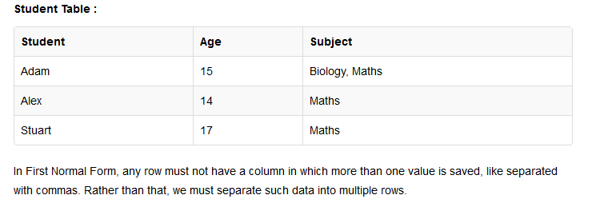
More Examples

Slide 31
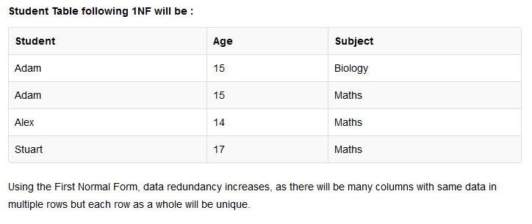

Slide 32
Second Normal Form (2NF)
As per the Second Normal Form there must not be any partial dependency of any column on primary key. It means that for a table that has concatenated primary key, each column in the table that is not part of the primary key must depend upon the entire concatenated key for its existence. If any column depends only on one part of the concatenated key, then the table fails Second normal form.
In example of First Normal Form there are two rows for Adam, to include multiple subjects that he has opted for. While this is searchable, and follows First normal form, it is an inefficient use of space. Also in the above Table in First Normal Form, while the candidate key is {Student, Subject}, Age of Student only depends on Student column, which is incorrect as per Second Normal Form. To achieve second normal form, it would be helpful to split out the subjects into an independent table, and match them up using the student names as foreign keys.

Slide 33
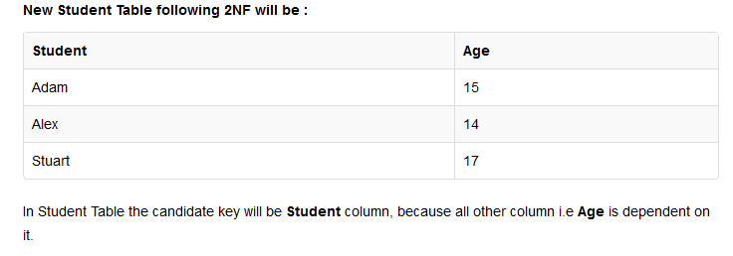

Slide 34
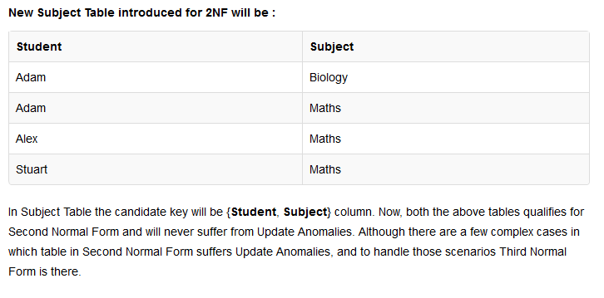

Slide 35
Third Normal Form (3NF)
Third Normal form applies that every non-prime attribute of table must be dependent on primary key, or we can say that, there should not be the case that a non-prime attribute is determined by another non-prime attribute. So this transitive functional dependency should be removed from the table and also the table must be in Second Normal form. For example, consider a table with following fields.
The advantage of removing transitive dependency is,
Amount of data duplication is reduced.
Data integrity achieved.

Slide 36
Boyce and Codd Normal Form (BCNF)
Boyce and Codd Normal Form is a higher version of the Third Normal form. This form deals with certain type of anamoly that is not handled by 3NF. A 3NF table which does not have multiple overlapping candidate keys is said to be in BCNF. For a table to be in BCNF, following conditions must be satisfied:
R must be in 3rd Normal Form
and, for each functional dependency ( X -> Y ), X should be a super Key.

Slide 37
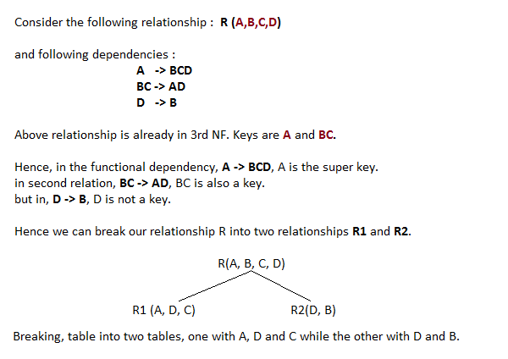

Slide 38
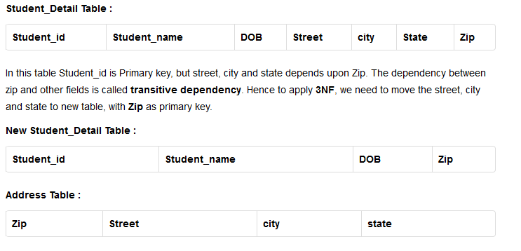

Slide 39
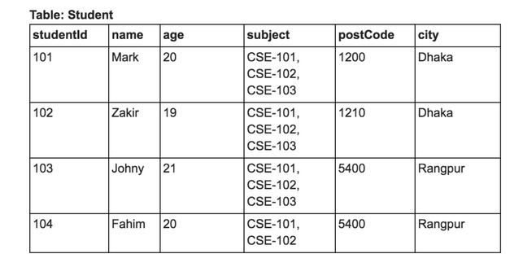
Relation without Normalization

Slide 40
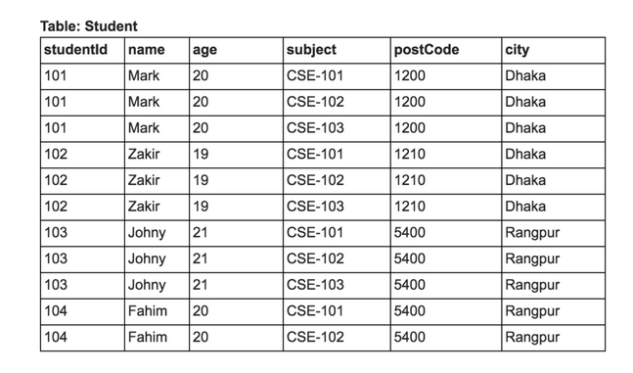
1NF
1NF

Slide 41
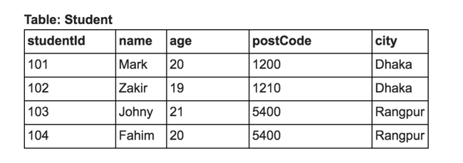
2NF
Non prime/non key attribute, cloud not depend on subset of candidate key
Candidate key→ {studentid, name}
Subset→ studentid

Slide 42
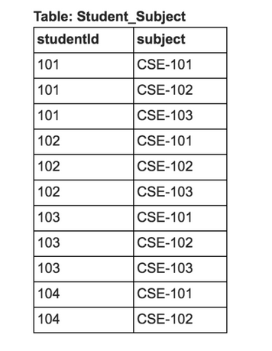
2NF

Slide 43
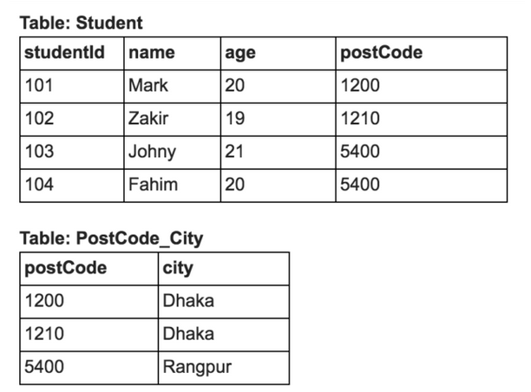
3NF
3NF

Slide 44
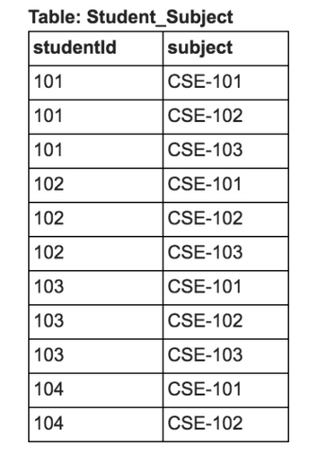
3NF

Slide 45
References
http://www.studytonight.com/dbms/database-normalization.php
http://beginnersbook.com/2015/05/normalization-in-dbms/
In Bengali..
http://subeen.com/%E0%A6%A8%E0%A6%B0%E0%A6%AE%E0%A6%BE%E0%A6%B2%E0%A6%BE%E0%A6%87%E0%A6%9C%E0%A7%87%E0%A6%B6%E0%A6%A8 %E0%A6%A1%E0%A6%BE%E0%A6%9F%E0%A6%BE%E0%A6%AC%E0%A7%87%E0%A6%9C/

Slide 46
Discuss with your Learning Partner.
What you have learn from this lecture?

